Slide 1

The Open School
Parent Information

Slide 2
The Open School History
Formed in 1971 – group of parents seeing alternatives
Used to be a primary school up to 3rd grade
Serving preschool/prek/tk
3-5 year olds
Board of Directors
Parent involvement
Unique and amazing place
You are part of
The Open School family!

Slide 3
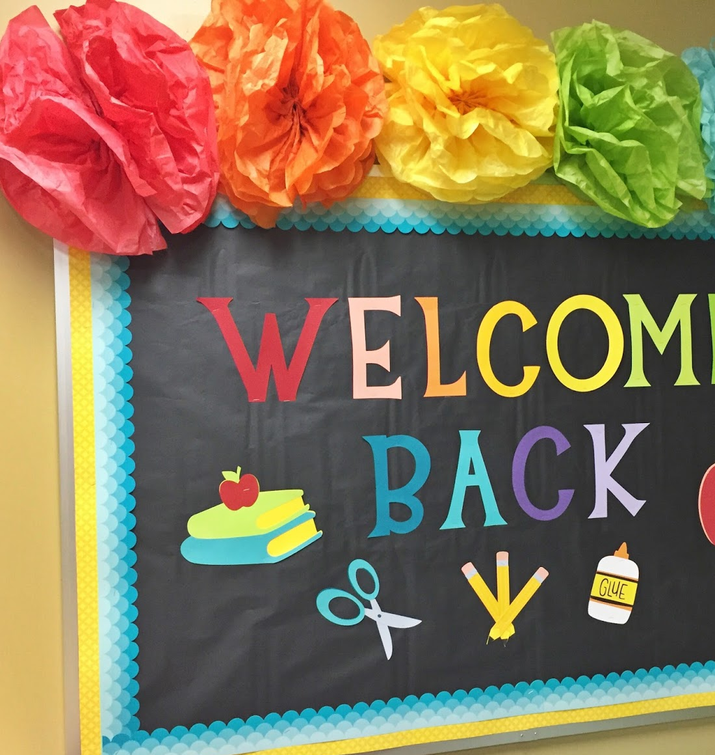
Lead Staff:
Shelly McFate – Director
Laura Shuler – PreK1 Teacher/Assistant Director
Reanna Schuckman – Transitional Kindergarten Teacher
Brea Moralez- Preschool Teacher
LeeAnna Guyett, PreK1 Assistant Teacher
Alison Comstock– Preschool Assistant Teacher
MJ Mossey – Transitional Kindergarten Asst Teacher
Lizzie Roth – Office Assistant, Classroom Support
Robert & Natellie Jenkins- Cleaners

Slide 4
Board of Directors
Stefanie Milam – President
Megan Candelaria - Vice-President/Treasurer
Maureen Disque -Secretary
Shelly Donner – Member
Ashlie Reese- Member
Brian Harrington - Member
Board applications on website, in office, in classrooms
Maintenance Committee
Fundraising Committee
Event Committee

Slide 5
Maintenance
Fall and spring maintenance days:
UW Big Event in October
May cleaning Saturday
See Shelly if you like to do yard work, move snow, have repair & maintenance
skills

Slide 6

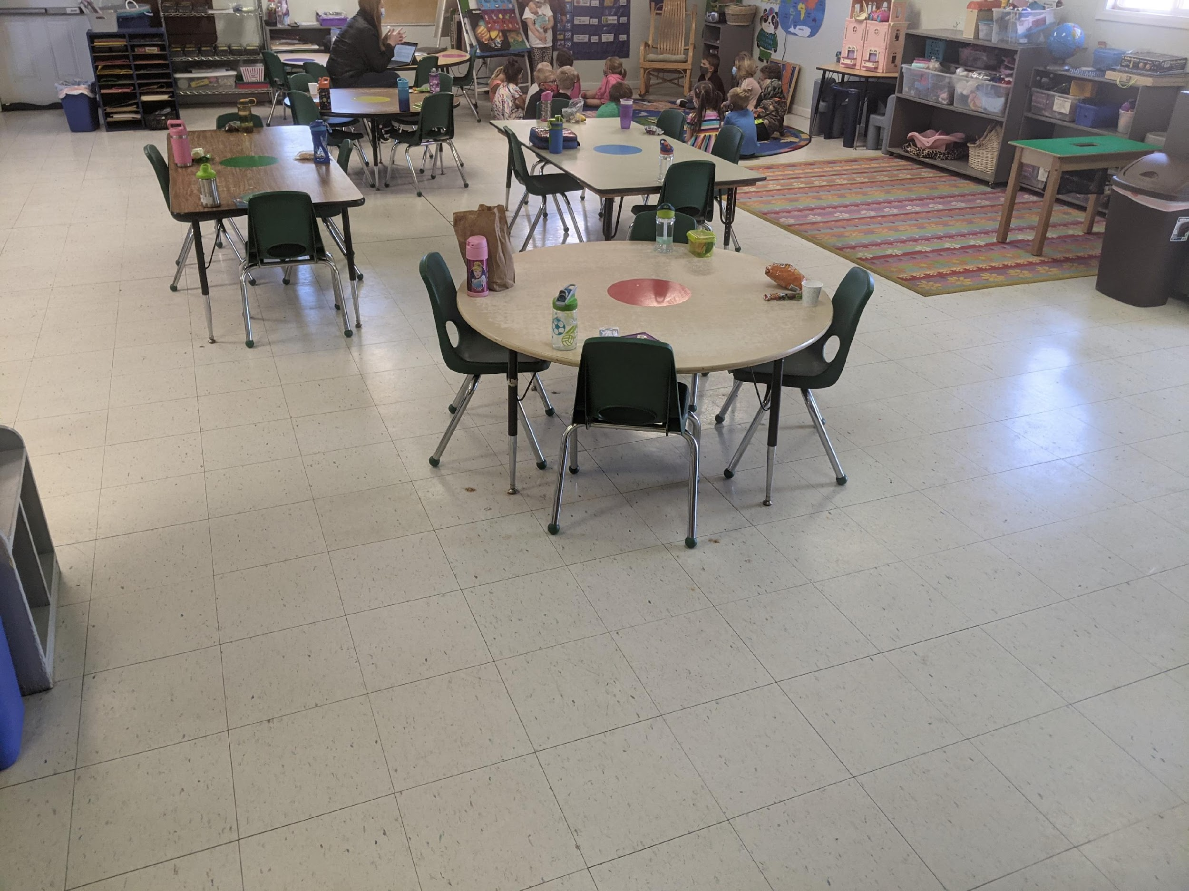

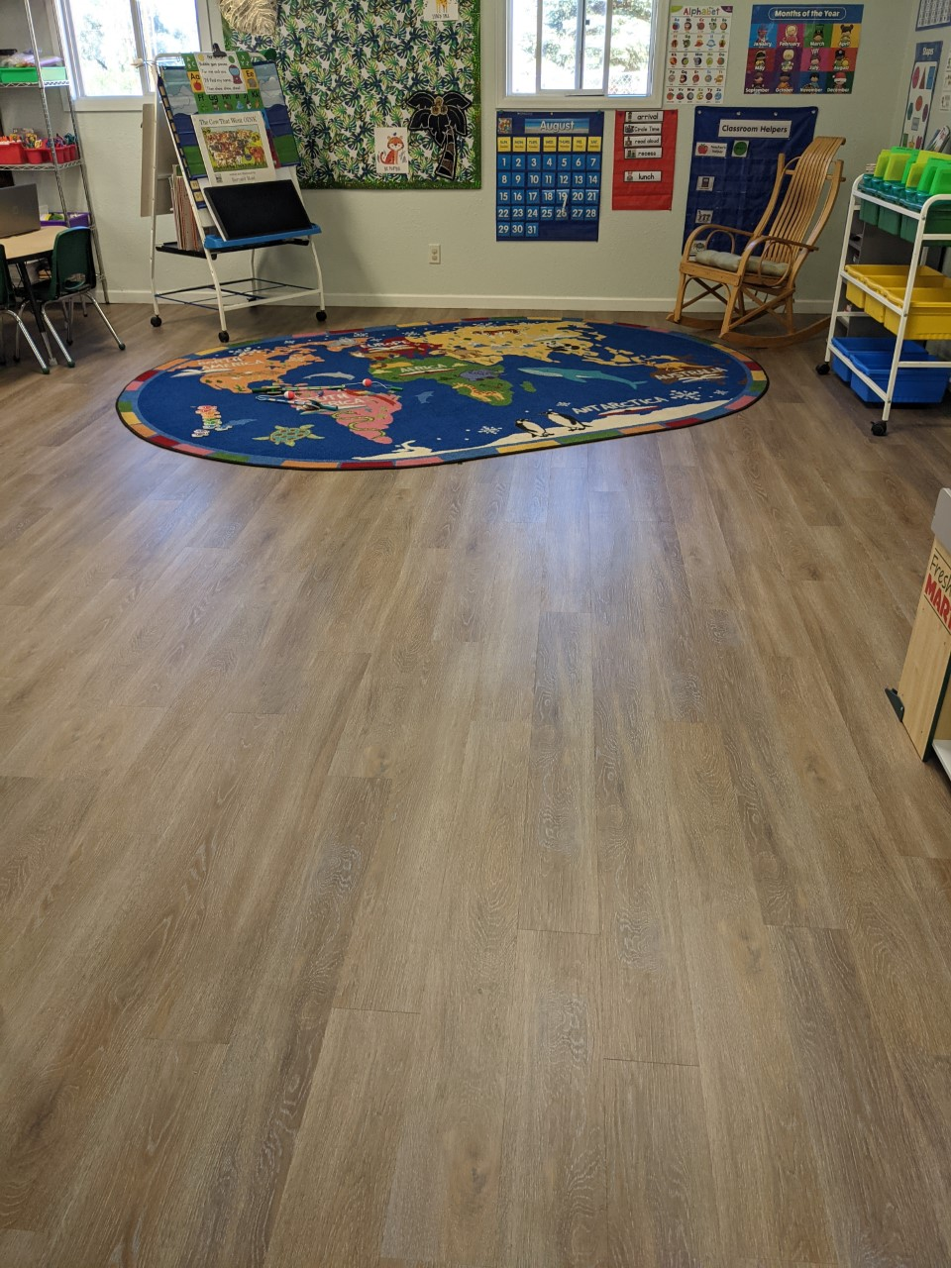
Fundraising Committee
Popcorn Fundraiser – before Christmas
WyoGives day in July – matching donors
Pledge sheet
Spring Raffle
Scholastic Book Fairs – 2x a year
Fundraising has paid for: new floors, vans, bike path, equipment, toys, shed, furniture, rugs, supplies

Slide 7
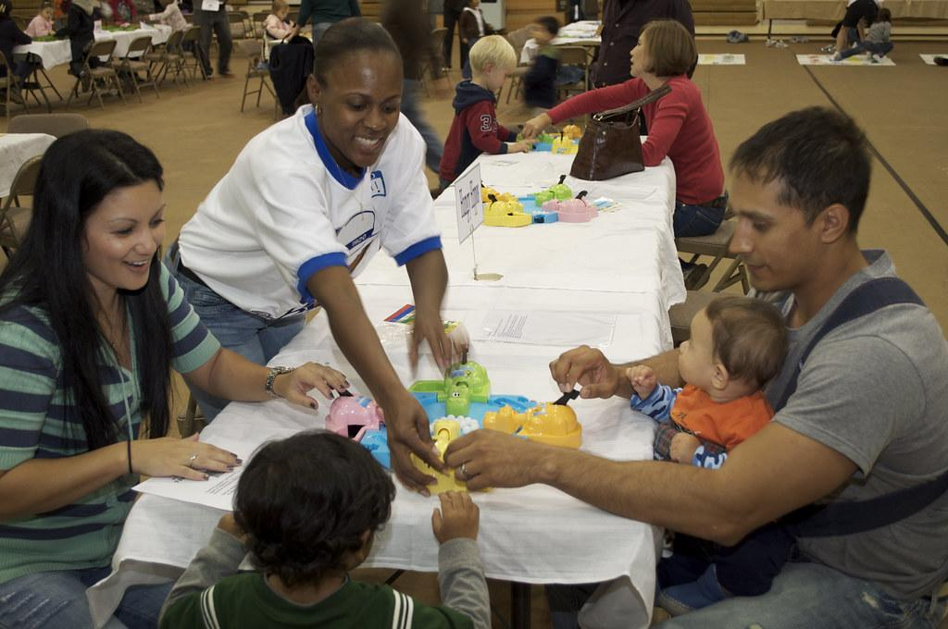
Family Nights & Events
Peppermint Parade
Art Show
Graduation
Family Nights
Field Trips
Event Committee

Slide 8
Daily School Schedule
7:20 a.m. to 8:30 a.m.
(Before School Care)
8:30 a.m. to 11:30 a.m.
(Morning Session)
11:30 a.m. to 12:30 p.m.
(Lunch)
12:30 p.m. to 3:00 p.m.
(Afternoon Session)
3:00 p.m. to 5:30 p.m.
(After School Care)
Please let us know if your child will be absent – app, email, call
No bell, but morning session carpet time generally starts by 8:30 once we get going in the year, being on time is helpful so your child doesn’t miss out on morning learning

Slide 9

Grace Period
Grace Periods are as follows:
Before School 7:30-8:30
No earlier than 7:20 a.m. or 10 minutes prior
Morning Session 8:30 a.m. – 11:30 a.m.
No earlier than 8:15 a.m. or 15 minutes prior
No later than 11:38 a.m. or 8 minutes after
Lunch Session 11:30 a.m. – 12:30 p.m.
No earlier than 11:22 a.m. or 8 minutes prior
No later than 12:38 a.m. or 8 minutes after
Afternoon Session 12:30-3:00
12:30 p.m. - 3:00 p.m. No earlier than 12:22 p.m. or 8 minutes prior
No later than 3:15 p.m. or 15 minutes after
3:00-5:30
Not available

Slide 10

Monthly Schedules
One-month notice to change schedules
Add on sessions – may or may not be available – see Shelly to check class ratios
We have a little bit of flexibility in schedules. See Shelly if you need to add a session on random days.
Pay for added extra sessions the following month
If you have a schedule change right now, see Shelly
Enrichment
Has to be regularly scheduled

Slide 11
Tuition Policy
The Open School is a non-profit organization.
Tuition is based on a yearly amount and is prorated over nine months Sept-May
Tuition payments –statements in cubbies, due between 1st-10th of each month, late fees will be applied daily after 10th
Schedule changes/withdrawal notice 30 days notice
No discount for missed days due to illness, vacation, etc.
No make-up days for missed days due to illness, vacation, etc.
No flexing of schedules – it is a monthly schedule, can be changed for the next month by visiting with Shelly to see availability to increase schedule or notify in writing to decrease schedule
Extra session fee $30, add a lunch $15
Pick up or drop off outside of package 25 cents a minute
Discounts for siblings, prepay semesters, or military families
Child Care Aware for military families
DFS assistance for those who qualify

Slide 12
Tuition Payment Options
Check
Pay by check – black box in office by bulletin board
Cash
Pay with cash
Cash – see Shelly or staff for receipt
Auto Draft
Pay by auto-draft checking- $1/month, out on 5th
  Forms in office
  Last year auto draft still active – unless you change or stop it
  You will still get a statement to review prior to the 5th
Credit
Online credit card – 2.75% transaction fee applied at end of month
Pay in office with credit card, 2.75% fee card swipe
Can set up auto-draft using credit card as well, these fees apply. Form is in the office
Prepay
Discount of 2.5% if prepay by the semester
Let Director know to bill that way (4 months first, 5 months second semester)
Must be paid by September 10 and January 10 for discount

Slide 13

Enrollment and
Supply Fees
$50 supply fee each semester (September & January charges)
$60 annual enrollment fee each year
Will be on first tuition statement in September if haven’t prepaid
Personal items such as water bottle, change of clothing, etc. were listed in newsletter

Slide 14

Meals and Snack Time
Lunch Time (avoid glass containers, red dye – new floors)
Water Bottles
Label snacks please
Morning Snack Time (can bring in more than 1 day at a time and leave in cubby or refrigerator)
After School Snack Time
Allergies - teachers will advise

Slide 15

Celebrations
Birthday Treats – check with teacher on amounts, allergies
Allergies – can store special treats in freezer or classroom as well
Holidays – we will celebrate and have class parties for holidays – watch for sign-up sheets for special occasions
Summer birthdays – check with teachers, not all in May please
Events - tbd

Slide 16

Picture Days
Spring & graduation portraits

Slide 17

Teaching Strategies:
Creative Curriculum
(1) blocks;
(2) dramatic play;
(3) toys and games;
(4) art;
(5) library;
(6) discovery;
(7) sand and water;
(8) music and movement;
(9) cooking;
(10) technology; and
(11) outdoors. Separate interest areas with varied materials offer children a clear range of choices.
Children learn through play!
Aligned with WY Early Learning Standards

Slide 18

Wyoming Early
Learning Standards
https://www.wyecplc.org/wyomings-early-learning-standards
http://wyecplc.org
Poster in office, materials can be downloaded or mailed
The Early Learning Standards is a tool that connects early childhood development with education in a variety of facets. It includes benchmarks, stories from the field, and much more.

Slide 19
Three Classrooms
What’s the Difference?
Preschool – Miss Brea’s Room
Our youngest students: 3-year-old children, potty trained, ready for fun and new experiences! Learning to be at school, will move up to PreK or TK the following year, depending on birthday and readiness.
PreKindergarten – Miss Laura’s Room
Traditional PreK ages: 4-year-old children, getting ready for Kindergarten, ready for fun and learning! Can move up to Miss Joni’s if birthday doesn’t meet cut-off, or if preferred to wait another year. Can go to Kindergarten if 5 by August 1st, or waiver approved
Transitional Kindergarten – Miss Reanna’s Room
Our oldest students: Turning 5 by December. Children who miss the August 1st Kindergarten cut-off date, or families want to wait one more year before starting K. Ready for fun and learning! All getting ready for Kindergarten.

Slide 20
Three Classrooms
What’s the Same?
All classes:
Teaching social/emotional skills, manage bodies, self-regulation skills
Teaching Strategies/Creative Curriculum and WY Early Learning Standards & common core of knowledge in accordance with the WY Dept of Education
Independence, flexibility, self confidence, curiosity are encouraged and nurtured
Individualized instruction – lots of ages/stages, developmentally appropriate learning opportunities
Teaching literacy, mathematics, science, social studies, arts, STEM
Allowing children to explore, have fun, learn at their pace
Providing a wide variety of experiences to enhance learning, whole child learning
Parent Teacher Conferences 2x a year to engage families in learning
Preparing children for future success and continued love of learning
Qualified and caring teachers – they are the best!

Slide 21

Other Curriculum & Enrichment
Learning Without Tears, Core Knowledge, Heggerty Phonics, Teaching Strategies
Fitness: Soccer, PE with UW, gym time
Swimming –both semesters for PreK, TK
Sign Language and Spanish
On Site – art, cooking, science
Library, UW art museum, field trips
Enrichment add-ons available first to full time students, then limited spots for part time students

Slide 22
Technology Use
Television Monitors
Newline Smart Board
Music, indoor recess, books, supplemental learning, etc
Movie party
Rated G,
permission and prior notice

Slide 23
Field Trips
The “Permission Slip for Field Trips” must be completed when students begin school.
Attending with child who doesn’t normally attend that session – discuss with the teacher. If a parent attends with a child – no charge, if we have room for child to attend without parent, then charged session fee. This only applies to field trips, not regularly scheduled enrichment offerings.
If parents prefer that their child not participate in a field trip, the parents are responsible for arranging other care for the child that day.
Arrive on time
May be scheduled, may be random – walks to parks, campus trips, etc.

Slide 24
Current Procedures
Drop off – drop off on playground or in classroom if still inside
Check in/out on phone with ProCare App
Picking up – on playground or in classrooms
Before/After school – in Miss Laura’s classroom
Lunches/snacks – may eat outdoors or indoors

Slide 25

If cones are out, reserve for vans
No U-turns please
Please do not block neighbors
Walk children to/from classroom or playground and check in with teacher on clipboard, as well as on ProCare app
We prefer only adults use the fence latches and not teach children to open/shut gates
Pick-up/Drop-off

Slide 26

Tears & Anxiety
*Honeymoon period
*Staff can assist
*We will let you know that they have calmed
*Positive parent regulation
*Solutions if ongoing
*We recognize this is
first experience for
some children
*Drop and go is easiest

Slide 27
ProCare
App – Pro Care Engage
Download app – invites sent to parents’ emails
Each parent/guardian should download app
Will be used to send reminders, photos, communication about our day
Contactless Check In/Out
Other people picking up or dropping off – manually check in/out with notebook , must be on child’s pick up sheet
App only works through the invite email
Communicate with teachers through the app (privately)
See Shelly for help with app

Slide 28
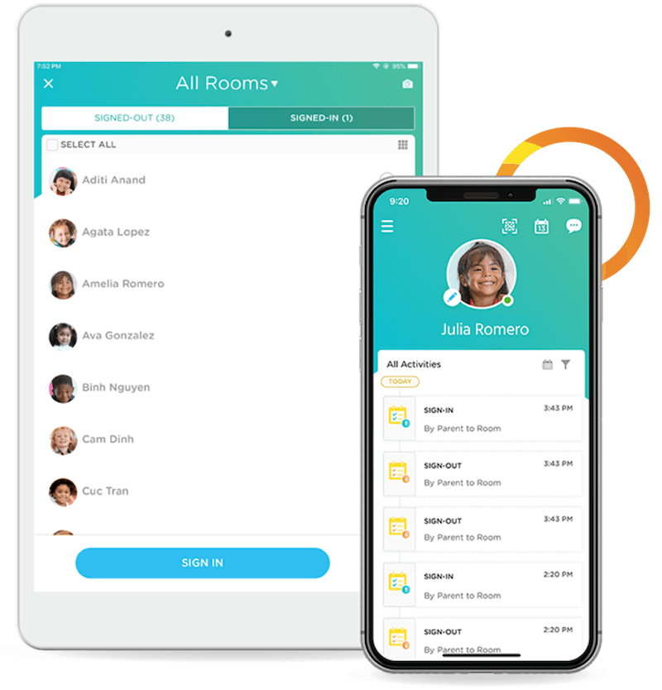
ProCare Engage
Procare Engage
Contactless Check In and Out – GeoFence
Open App – QR code symbol right top, prompted that you are at the school, check in/out
Signature at check in
Instructions:
https://www.procaresupport.com/procare-online/docs/parents-getting-to-know-your-procare-app-1

Slide 29

Release of Child to Non-Parent Or Guardian:
*Parent/Guardian Complete Release Form
*They must be on release form
*They must bring ID
*Check in/out manually with staff

Slide 30

Sunscreen
If your child should use only their own bottle, please talk to teacher, label their personal bottle, and give to teacher
Face stick – individual use
Spray bottles – shared unless told otherwise
Helpful to arrive sun screened at drop off during warm weather

Slide 31

Playground
Walk children to/from gate
Staff at gate to check in on clipboards
Playground rules taught to children
End of day and beginning of day – smooth transition time
Please make sure siblings are supervised –mixed ages playing
Keeping children safe #1 job
Rocks/sand/mulch left in proper areas
Shoes fill with sand – sneakers are great!

Slide 32

Bike Path
Bring helmet, fitted, labeled – must be worn if riding
Bike path closed at drop off recess and when weather dictates
Bringing own bikes
No walking on path if riders are present
No pushing trucks on path

Slide 33

Clothing
Labeled please
Comfortable clothing
Please send hats, coats, mittens, boots, and shoes for students to change into in cold weather – extras if you have them
Extra change of clothes
No pull-ups
Slippers/indoor shoes
Lost and found in office
Bathroom accidents
Sneakers left here for walking, PE, etc.
Lost and Found in the office

Slide 34

Illness Policy
Illnesses are outlined in parent handbook
All illnesses: 24 fever free without medications, symptom free
Please do not medicate for fever/vomiting/heavy cough and then send to school, medication wears off and symptoms reappear
If someone in household has been diagnosed or exposed, comply with public health orders for isolation/quarantine/testing (do not attend school if positive)
Teachers will call parents immediately and send a student home if they observe symptoms of illness during the school day. Need to have children picked up asap (within 30 minutes).
If the child requires antibiotics for treatment of any illness, please keep the child out of school until the child has been on the antibiotic for a minimum of 24 hours.
If not well enough to participate in scheduled activities – recess, swimming, etc, then not well enough for school – no extra staff to monitor indoor recess or one child sitting out of swimming, etc.
Exceptions – see Director if short-term accommodations are medically

Slide 35
Illness Notification
We will notify parents of a contagious illness outbreak.
Please notify the school if absent and reason.
When any reportable communicable diseases occurs and teachers, staff, or students have been exposed, the School shall immediately advise all staff and parents to allow them to observe for symptoms. The specific identify of the person(s) infected shall not be revealed except to authorized health authorities if required by law.
(Communicable diseases listed in handbook). Contact tracing by public health would occur.

Slide 36

Medication Administration
Medication Administration Request
Complete Instructions Form
All medications checked in with staff
No medication in cubbies or backpacks – including hand sanitizer, chapsticks, lotions, etc – talk to teacher about storage of products
Certified staff will administer
Asthma inhalers check these items in with Shelly
Allergies – please see Shelly to complete an allergy ER plan and leave EpiPen and/or other meds

Slide 37
Parent Responsibilities
Volunteer
Help Fundraise
Read Parent Handbook
Turn in All Required Forms (notes in cubbies with anything missing)
Returning families – enrollment update form in cubbies
Attendance
Comply with school policies
Communicate with teachers/director
Read information – newsletters, emails, messages
Communicate directly with lead teachers for concerns, or see Shelly. Support staff relay messages

Slide 38
Communication
Parent-Teacher Conferences
School Calendar
Newsletters
Facebook Laramieopenschool
Website The website address is: www.laramieopenschool.org
School Alerts will be posted on website
Teacher/Director e-mail - available from 8:00 a.m.-5:00 p.m.
ProCare app

Slide 39
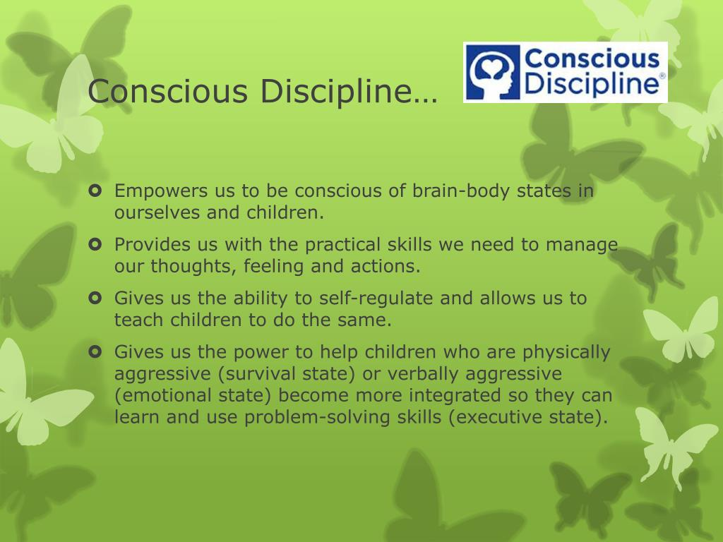
Discipline Policy
The Open School focuses on positive guidance, such as redirection, natural and logical consequences, modeling of positive behavior, and other non-punitive methods of discipline. Teaching self regulation and social and emotional skill development is part of our curriculum and a goal of preschool education.
Conscious Discipline
Dr. Becky Bailey – Conscious Discipline website, FB, YouTube
Social/emotional regulation first step and important piece of preschool

Slide 40

Al’s Pals
Teaching Strategies
A Nationally recognized, Evidence-based
Social-Emotional Learning Curriculum
The National Center on Quality
Teaching and Learning
Rated highest level of evidence of effectiveness
Department of Education
Designated Effective School-Based Prevention Program
Build the foundation children need for success in school and life
Through fun lessons, engaging puppets, original music, and effective teaching approaches, Al’s Pals:
helps children manage feelings and behaviors;
cultivates conflict resolution and problem-solving skills
builds positive relationships and prevents bullying
creates caring, cooperative classrooms
teaches children to make healthy choices
builds authentic family partnerships, family engagement and letters

Slide 41
Developmental Screenings
In September– here at the school
Paperwork in cubbies prior to screening, only screened if paperwork is completed and returned
(optional, free, recommended)
Developmental screenings are for children age birth to 5 years old and are conducted by highly qualified Early Childhood Specialists and include detailed looks at vision, hearing, cognitive abilities, social/emotional development, speech, language, gross motor skills and fine motor skills.
Families residing within Albany County, Wyoming can get information and access to developmental services, childcare and other services by clicking on the link to the left.
Early Intervention Office:
1771 Centennial Drive, Suite 220
Laramie, WY 82070
Phone: (307) 742-3571

Slide 42
On-Going Discipline Issues
1) The problem will be discussed with the child to select an alternative behavior option. Should the behavior continue…
2) The problem will be discussed with parent(s) and staff with face-to-face communication. Should the behavior continue…
3) The problem will be addressed in a formal meeting with parent(s) and all other staff members. At the meeting, a written action plan will be developed with required approval of the staff members. This plan of action should ask for an appropriate level of involvement from the parent(s). Should the behavior continue…
4) The Board of Directors will be contacted and will meet with the staff member(s) and parent(s) to discuss options and address the problem. The Board will review the situation and make its recommendations for resolution. The child may be suspended or the parents may be asked to withdraw their child from the program.
If a child is exhibiting disruptive behavior to the point that is disturbing the students or creating a dangerous situation, the parent(s) will be called to the school to remove the child immediately.

Slide 43

Drills
Fire
Tornado
Snow Days
Gas Leaks/Other
Lock Down Procedure
Active Shooter

Slide 44
Additional Policies
Available in parent handbook:
WEAPONS POLICY
TOBACCO/ALCOHOL/DRUG POLICY
ANIMAL POLICY

Slide 45


Blue box on sidewalk in front under tree
Take a book, leave a book, or small toys like puzzles, things to share with other families
Open to the community – mapped on
Littlefreelibrary.org

Slide 46

Tuesday 8/25 first day 11:30 dismissal (district wide)
We are excited for a new school year! Please see your child’s teacher or Shelly with any questions, we are happy to help or clarify!

