Slide 1
Copy & Paste these table, boxes, and formats into any template you like. EVERYTHING in this file, except the images, is editable. Make boxes, fonts, and shapes larger, smaller, or a different format altogether!
Font used in this: KG Primary Penmanship 2 (free on TPT)
Text Goes Here
Text Goes Here
Column One | Column One
Important Dates
Text
 | Breakfast | Lunch
Monday
Tuesday
Wednesday
Thursday
Friday
Text | Text

Slide 2
Page 2 – Includes shapes and different dividers. You might use these for notes that need to stand out and/or for separating information.
Pages 3 & 4 – Include some alternate formatting options for the newsletters text. All boxes can be manipulated to fit your needs.
Text
Text
Text
…….
====
-----
……
*******
…….
-----
====
……
*******

Slide 3
MONTH
The Week of xxxxxxxxxxxxxx
Email: {teacher’s email address}
Twitter: @twitteraccount Website: classwebsite.com
Important Dates
Reminders
Text
Text
Our Month of Learning

Slide 4
MONTH
The Week of xxxxxxxxxxxxxx
Email: {teacher’s email address}
Twitter: @twitteraccount Website: classwebsite.com
Reminders
Important Dates
Text
Text
Our Month of Learning
Needed
Text

Slide 5
Reminders
Important Dates
Text
Text
Our Month of Learning
Needed
Text
Needed
Text

Slide 6

Our __ Grade
Classroom News
The Week of xxxxxxxxxxxxxx
Email: {teacher’s email address}
Twitter: @twitteraccount Website: classwebsite.com
Important Dates
Reminders
Text
Text
Supporting Your Student at Home
What We’re Learning This Week
Reading | Math | Science | Social Studies

Slide 7

Pre-K 1 Classroom News
The Week of August 26nd
Email: prek1class@laramieopenschool.org
Important Dates
Reminders
October 8th – Maintenance Day and the Big Event 9-12
Developmental Screening is October 11th and 12th
P/T Conferences Week of October 24th
Spanish will begin this week at 10:30a.m. on Wednesday. P.E. and storytime will also resume this week.
News
What We’re Learning This Week
We will do some activities with apples this week as we celebrate the first full week of fall! We will taste test and graph apples and make apple pie in a cup for cooking. The kids are all doing great falling into the routine and continue to make new friends each day! Thanks! –Ms. Laura

Slide 8

Our __ Grade
Classroom News
The Week of xxxxxxxxxxxxxx
Email: {teacher’s email address}
Twitter: @twitteraccount Website: classwebsite.com
Important Dates
Reminders
Text
Text
What We’re Learning
Reading | Math | Science | Social Studies
Supporting Your Student at Home

Slide 9

Our __ Grade
Classroom News
The Week of xxxxxxxxxxxxxx
Email: {teacher’s email address}
Twitter: @twitteraccount Website: classwebsite.com
Important Dates
Reminders
Text
Text
Supporting Your Student at Home
What We’re Learning This Week
Reading | Math | Science | Social Studies

Slide 10

Our __ Grade
Classroom News
The Week of xxxxxxxxxxxxxx
Email: {teacher’s email address}
Twitter: @twitteraccount Website: classwebsite.com
Important Dates
Reminders
Text
Text
Supporting Your Student at Home
What We’re Learning This Week
Reading | Math | Science | Social Studies

Slide 11

Our __ Grade
Classroom News
The Week of xxxxxxxxxxxxxx
Email: {teacher’s email address}
Twitter: @twitteraccount Website: classwebsite.com
Important Dates
Reminders
Text
Text
Supporting Your Student at Home
What We’re Learning This Week
Reading | Math | Science | Social Studies

Slide 12
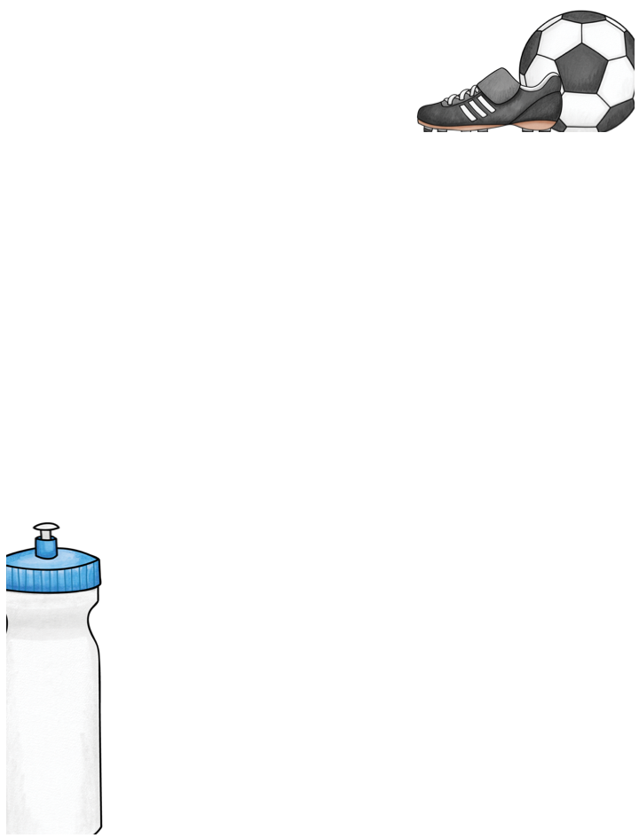
Our __ Grade
Classroom News
The Week of xxxxxxxxxxxxxx
Email: {teacher’s email address}
Twitter: @twitteraccount Website: classwebsite.com
Important Dates
Reminders
Text
Text
A—Home Practice
Type Important
Reminder Here
What We’re Learning This Week
Reading | Math | Science | Social Studies

Slide 13

Our __ Grade
Classroom News
The Week of xxxxxxxxxxxxxx
Email: {teacher’s email address}
Twitter: @twitteraccount Website: classwebsite.com
Important Dates
Reminders
Text
Text
At-Home Practice
Type Important Reminder Here
What We’re Learning This Week
Reading | Math | Science | Social Studies

Slide 14
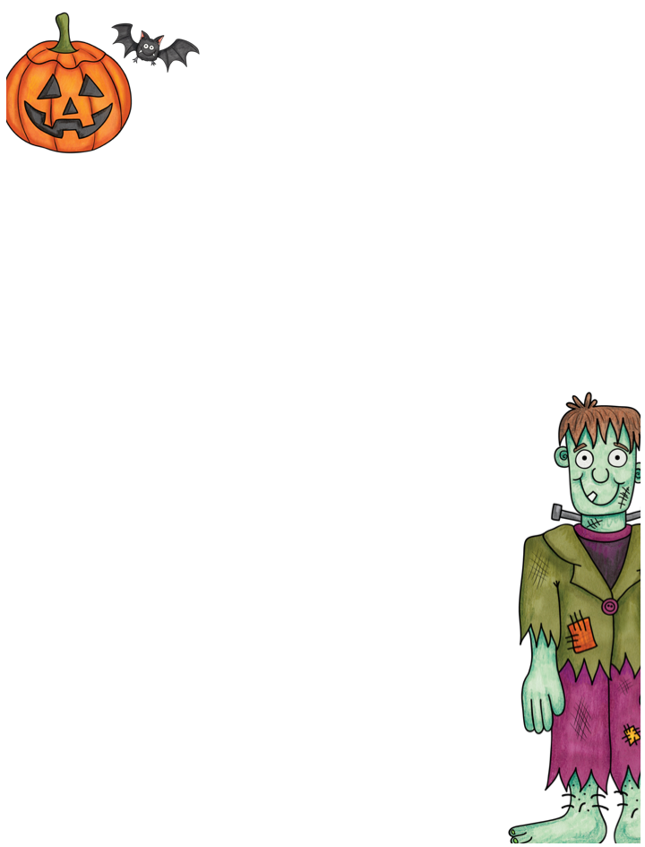
PreK 1
Classroom News
The Week of October 24th
Email: prek1class@laramieopenschool.org
Important Dates
Reminders
October 26th P/T Conf. afternoon
October 26th 11:30 pick up
October 27th/28th School Closed
October 31st – Halloween party 10a.m.-11a.m.
Halloween costume parade 11:15 a.m.
Wednesday is a half day with pick up at 11:30 a.m. There is no lunch or after school. We will also have a pajama day on Wednesday. Kids can dress in their favorite PJ’s if they want. Thursday and Friday the school is closed. We will return on Monday for our Halloween party. Kids can wear costumes to school and all day if they would like to. We will probably be active in the afternoon so a change of clothes would be a good idea if your child stays all day. Thanks!
News
We will enjoy some fun Halloween crafts and activities this week as we prepare for the big day. Please check cubbies to make sure extra clothes are weather appropriate( long pants, long sleeve shirts, etc.)
What We’re Learning This Week

Slide 15

Pre-K
Classroom News
The Week of October 17TH ,2022
Email: prek1class@laramieiopenschool.org
Important Dates
Please bring a swimsuit, towel and bag for swimming on Wednesday afternoon
Reminders
October 20th and 26th P/T Conferences
October 31st – Halloween Party 10 a.m.
I will be sending home a few papers in a folder prior to conferences. These papers are for you to look over before conferences, along with a name paper for home use. Please note these are just observations I made during assessments. Your children may tell you more, as they always feel comfortable sharing more with mom and dad. I just use these assessments to outline curriculum for the year as we head toward the end goal of kindergarten and prek-2. Thank you.
News
We started swimming Wednesday afternoon and everyone did great. P.E. will continue this week on Monday and Friday afternoon. We will explore the life cycle of a pumpkin, graph Halloween items and continue our name writing and letter recognition. Thanks!
What We’re Learning This Week

Slide 16

PreK
Classroom News
The Week of November 14th
Email: prek1class@laramieopenschool.org
School closed Nov. 23rd-27th Thanksgiving Break
Peppermint Parade Dec. 8th 6p.m. Civic Center
Reminders
Important Dates
Please bring a swimsuit, towel and bag for Wed. afternoon swim class
The book fair will be in the office beginning November 28th. Please be on the look out for some PJ’s for our pajama drive. Thank you!
The fall family night will be on Thursday evening from 6-7p.m. Please join us for some fun!
News
What We’re Learning This Week
We will enjoy some fun Thanksgiving activities and crafts this week. We will be sending home a special Thanksgiving gift the kids made for their family. Thanks!

Slide 17
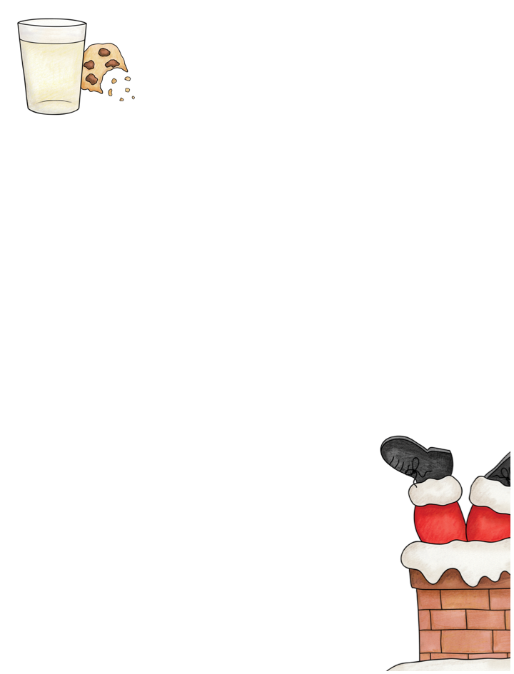
PreK
Classroom News
The Week of December 18th
Email: prek1class@laramieopenschool.org
Important Dates
Reminders
December 22nd- January 7th Winter Break
Have a great winter break!
We will be cleaning out cubbies on Wednesday morning. Items will be bagged up, so please take everything home that day, including slippers. Kids can just wear outside shoes on Thursday morning
News
We are going to be doing some fun holiday activities this week. Don’t forget the Holiday Spirit week! Thanks!
What We’re Learning This Week

Slide 18
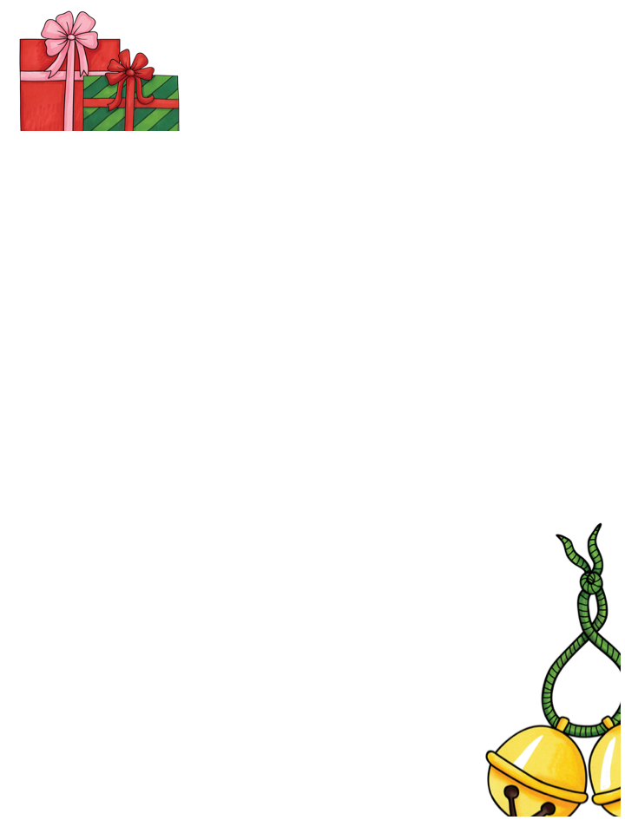
Our __ Grade
Classroom News
The Week of xxxxxxxxxxxxxx
Email: {teacher’s email address}
Twitter: @twitteraccount Website: classwebsite.com
Important Dates
Reminders
Text
Text
Supporting Your Student at Home
What We’re Learning This Week
Reading | Math | Science | Social Studies

Slide 19
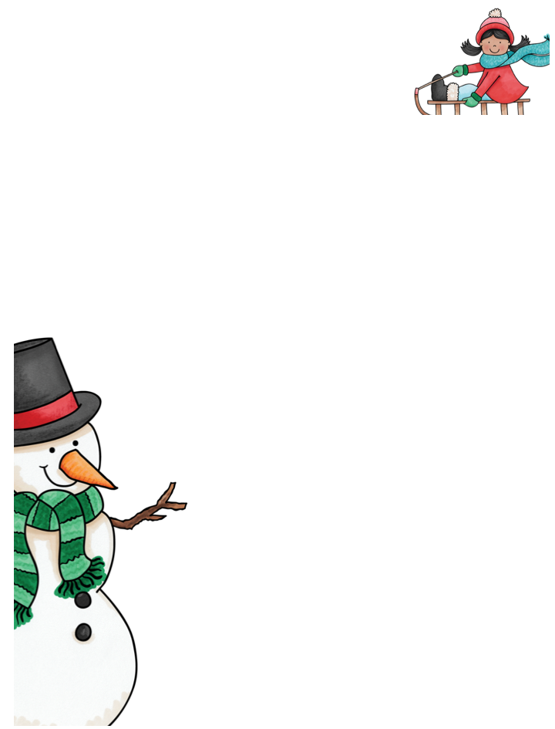
Our __ Grade
Classroom News
The Week of xxxxxxxxxxxxxx
Email: {teacher’s email address}
Twitter: @twitteraccount Website: classwebsite.com
Important Dates
Reminders
Text
Text
Supporting Your Student at Home
What We’re Learning This Week
Reading | Math | Science | Social Studies

Slide 20

Pre K
Classroom News
The Week of January 22nd
Email: prek1class@laramieopenschool.org
Feb. 5th – 100th Day of School
Feb. 14th Valentines Day party
Thanks for bringing water bottles, boots and snowpants
Important Dates
Reminders
News
We will begin swimming for the semester on Wednesday at 1:30. Please bring a suit, towel and bag.
We will finish our unit on Fairy Tales this week. We will sequence the Three Billy Goat Gruff and make queen of heart tarts. We are working on the sound of “sh”. Thanks!
What We’re Learning This Week

Slide 21

Our __ Grade
Classroom News
The Week of xxxxxxxxxxxxxx
Email: {teacher’s email address}
Twitter: @twitteraccount Website: classwebsite.com
Important Dates
Reminders
Text
Text
Supporting Your Student at Home
What We’re Learning This Week
Reading | Math | Science | Social Studies

Slide 22

Our __ Grade
Classroom News
The Week of xxxxxxxxxxxxxx
Email: {teacher’s email address}
Twitter: @twitteraccount Website: classwebsite.com
Important Dates
Reminders
Text
Text
Supporting Your Student at Home
What We’re Learning This Week
Reading | Math | Science | Social Studies

Slide 23

PreK
Classroom News
The Week of February 13th
Email: prek1class@laramieopenschool.org
Important Dates
Reminders
Feb. 14 -Valentine’s Day Party 10-11a.m.
Feb. 17^{th-} Half Day 11:30 a.m. Dismissal
Feb.20th -No School Staff Development
Swimsuit, towel and bag for Wednesday afternoon swim lesson
The Valentine’s Day party is from 10-11 a.m. on Tuesday. We will pass out valentines, have a special snack and play a few games. You can help your child pass out valentines at drop off or you can leave them in a bag in cubbies and we will help them later in the morning. Valentine boxes will be on top of cubbies Tuesday morning.
News
We will have our party on Tuesdays and celebrate friends and kindness this week. We will start our ocean unit next.
What We’re Learning This Week

Slide 24

Our __ Grade
Classroom News
The Week of xxxxxxxxxxxxxx
Email: {teacher’s email address}
Twitter: @twitteraccount Website: classwebsite.com
Important Dates
Reminders
Text
Text
Supporting Your Student at Home
What We’re Learning This Week

Slide 25

Pre K
Classroom News
The Week of April 29th
Email: prek1class@laramieopenschool.org
Important Dates
Reminders
May 9th Graduation 6-7pm civic center south gym
May 24th Last day of school
Please bring in sunscreen for face thanks!
News
Maintenance day has been postponed due to the upcoming weather forecast. We will try for Saturday, May 4th from 9-12pm
We will be starting a unit on space. We will visit the UW Planetarium on Tuesday May 7th from 1:15-2pm. If your child does not come Tuesday afternoons and you want to meet us with your child for the show, please let me know so I can get a head count. Thank you!
What We’re Learning This Week

Slide 26

Our __ Grade
Classroom News
The Week of xxxxxxxxxxxxxx
Email: {teacher’s email address}
Twitter: @twitteraccount Website: classwebsite.com
Important Dates
Reminders
Text
Text
Supporting Your Student at Home
What We’re Learning This Week
Reading | Math | Science | Social Studies

Slide 27

Our __ Grade
Classroom News
The Week of xxxxxxxxxxxxxx
Email: {teacher’s email address}
Twitter: @twitteraccount Website: classwebsite.com
Important Dates
Reminders
Text
Text
Supporting Your Student at Home
What We’re Learning This Week
Reading | Math | Science | Social Studies

Slide 28

Our __ Grade
Classroom News
The Week of xxxxxxxxxxxxxx
Email: {teacher’s email address}
Twitter: @twitteraccount Website: classwebsite.com
Important Dates
Reminders
Text
Text
Supporting Your Student at Home
What We’re Learning This Week
Reading | Math | Science | Social Studies

Slide 29

Our __ Grade
Classroom News
The Week of xxxxxxxxxxxxxx
Email: {teacher’s email address}
Twitter: @twitteraccount Website: classwebsite.com
Important Dates
Reminders
Text
Text
Supporting Your Student at Home
What We’re Learning This Week
Reading | Math | Science | Social Studies

Slide 30
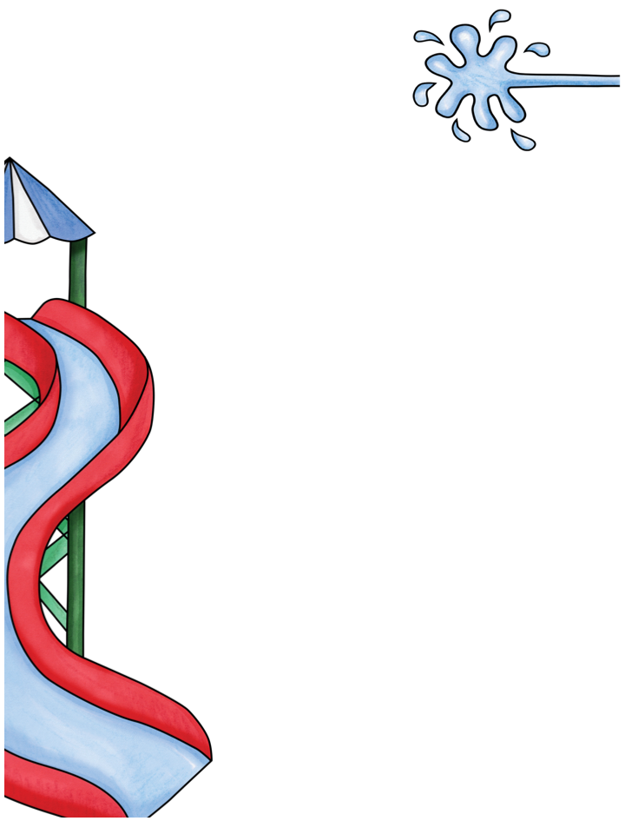
Our __ Grade Classroom News
The Week of xxxxxxxxxxxxxx
Email: {teacher’s email address}
Twitter: @twitteraccount Website: classwebsite.com
Important Dates
Reminders
Text
Text
Supporting Your Student at Home
What We’re Learning This Week
Reading | Math | Science

Slide 31

PreK
Classroom News
The Week of April 1st
Email: prek1class@laramieopenschool.org
Important Dates
Reminders
P/T Conf. April 3rd and 11th
No School April 12th
Swimming continues through April 10th
News
If you have any cleaned, plastic recyclables could you save them and bring them in before April 10th? We will be building a robot during the Week of the Young Child. Thank you!
We will end the ocean unit this week as we look at the abyss and trench parts of the ocean. If your child has a birthday coming up, they are welcome to bring treats just let me know what day and I’ll let you know the class sized for the day. Thanks!
What We’re Learning This Week

Slide 32
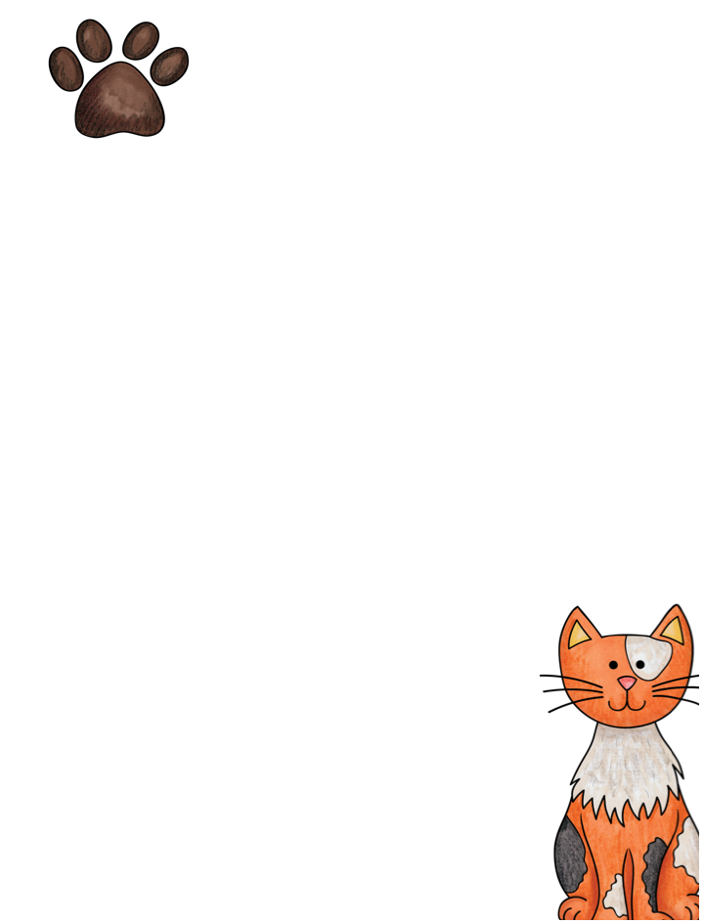
Our __ Grade
Classroom News
The Week of xxxxxxxxxxxxxx
Email: {teacher’s email address}
Twitter: @twitteraccount Website: classwebsite.com
Important Dates
Reminders
Text
Text
Supporting Your Student at Home
What We’re Learning This Week
Reading | Math | Science | Social Studies

Slide 33

Pre K Classroom News
The Week of May 6^{h}
Email: prek1class@laramieopenschool.org
Important Dates
Reminders
May 9– Graduation, end of year celebration Civic Center South Gym 6-7pm
May 24th- Last Day of School
Thanks for bringing layers for the spring days
We are going to the Planetarium on Tuesday, May 7th from 1:15-2pm. If you would like to join us if your child does not attend Tuesday afternoons, let me know and you can meet us at the Physical Science building at 1. You can also meet us to watch with your child if they are already at school.
News
We will wrap up our unit on Space this week and finish the year with some fun special activities. Mother’s Day gifts will go home Wednesday. They will need to be opened and watered asap ;)
What We’re Learning This Week

Slide 34
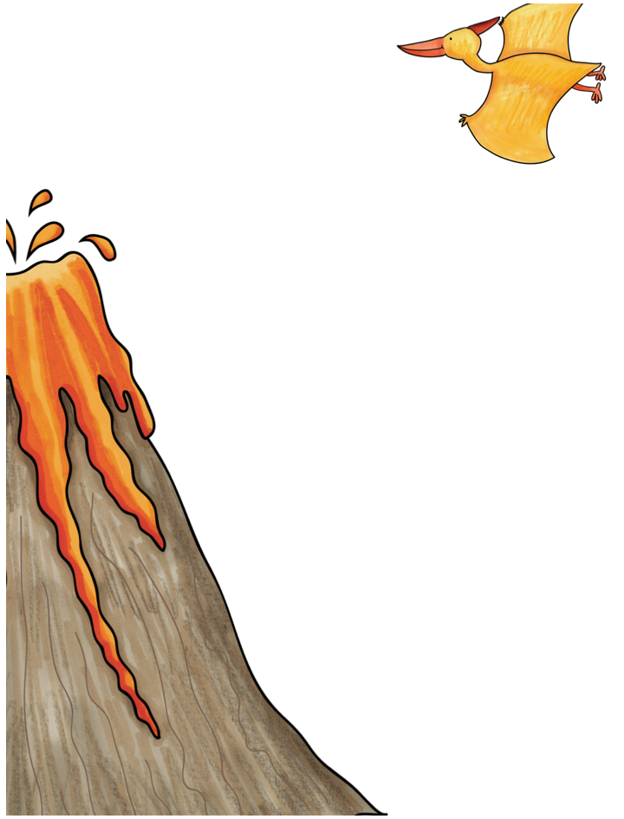
PreK
Classroom News
The Week of March 4th
Email: prek1class@laramieopenschool.org
Please bring a towel, suit and bag for swimming
Important Dates
Reminders
Spring Break Mar.11-15
News
Swimming will now extend through April 10th since we had a canceled session earlier in February.
Please take home snow clothes and water bottles over spring break for a good cleaning, slippers and extra clothes can stay in cubbies.
What We’re Learning This Week
We will head to the UW Geology museum on campus on Wednesday, March 6th. We will be at the museum from 10-11am if any parent would like to join us for the trip. We don’t do a guided tour, just a fun look around the museum and the T-Rex at the entrance. Thanks!

Slide 35

Our __ Grade
Classroom News
The Week of xxxxxxxxxxxxxx
Email: {teacher’s email address}
Twitter: @twitteraccount Website: classwebsite.com
Important Dates
Reminders
Text
Text
Supporting Your Student at Home
What We’re Learning This Week
Reading | Math | Science | Social Studies

Slide 36

Our __ Grade
Classroom News
The Week of xxxxxxxxxxxxxx
Email: {teacher’s email address}
Twitter: @twitteraccount Website: classwebsite.com
Important Dates
Reminders
Text
Text
Supporting Your Student at Home
What We’re Learning This Week
Reading | Math | Science | Social Studies

Slide 37
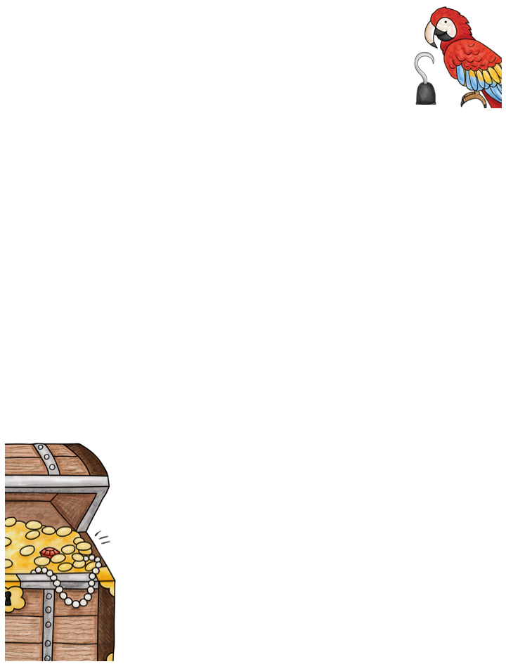
Our __ Grade
Classroom News
The Week of xxxxxxxxxxxxxx
Email: {teacher’s email address}
Twitter: @twitteraccount Website: classwebsite.com
Important Dates
Reminders
Text
Text
Supporting Your Student at Home
What We’re Learning This Week
Reading | Math | Science | Social Studies

Slide 38
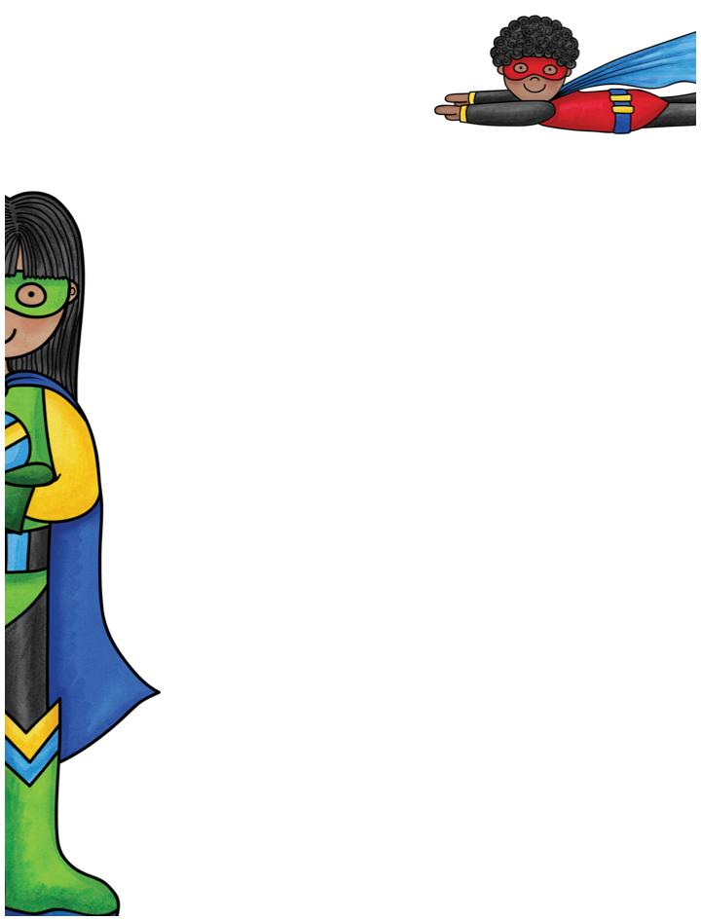
Our __ Grade
Classroom News
The Week of xxxxxxxxxxxxxx
Email: {teacher’s email address}
Twitter: @twitteraccount Website: classwebsite.com
Reminders
Reminders
Text
Text
Supporting Your Student at Home
What We’re Learning This Week
Reading | Math | Science | Social Studies

Slide 39

PreK
Classroom News
The Week of April 22nd
Email: prek1class@laramieopenschool.org
Important Dates
Reminders
Book Fair- through April 26th
Graduation May 9th 6-7pm Civic Center South gym
Please continue to bring warm clothes for outside!
We will head to the Herbarium and the Barry Center on Thursday morning to look at some rainforest plants at the herbarium and some reptiles at the Barry Center. We will be on campus from 10-11am
News
We will look at the understory and forest floor this week and explore what animals and insect life live there.
What We’re Learning This Week

Slide 40
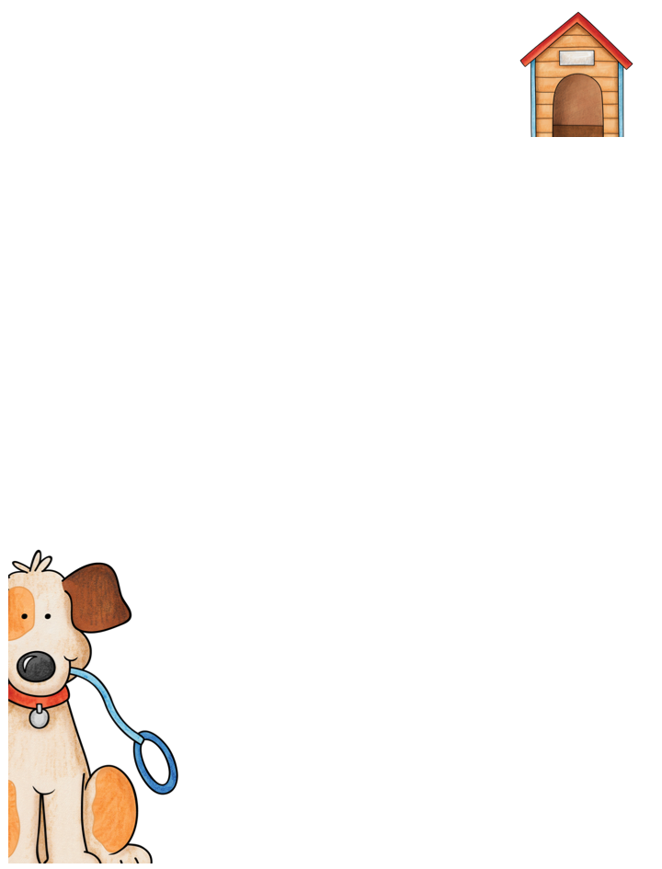
Our __ Grade
Classroom News
The Week of xxxxxxxxxxxxxx
Email: {teacher’s email address}
Twitter: @twitteraccount Website: classwebsite.com
Important Dates
Reminders
Text
Text
Type Important
Reminder Here
Supporting Your Student at Home
What We’re Learning This Week
Reading | Math | Science | Social Studies

Slide 41

Our __ Grade
Classroom News
The Week of xxxxxxxxxxxxxx
Email: {teacher’s email address}
Twitter: @twitteraccount Website: classwebsite.com
Important Dates
Reminders
Text
Text
Supporting Your Student at Home
What We’re Learning This Week
Reading | Math | Science | Social Studies

Slide 42
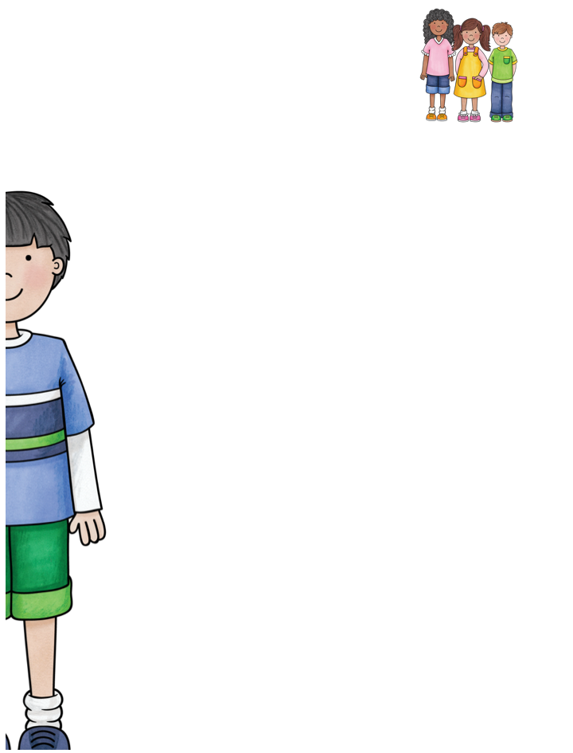
Our __ Grade
Classroom News
The Week of xxxxxxxxxxxxxx
Email: {teacher’s email address}
Twitter: @twitteraccount Website: classwebsite.com
Reminders
Reminders
Text
Text
Supporting Your Student at Home
What We’re Learning This Week
Reading | Math | Science | Social Studies

Slide 43

PreK Classroom News
The Week of January 16th
Email: prek1class@laramieopenschool.org
Please make sure to take home water bottles regularly to keep germs down- Thanks!
Important Dates
Reminders
^{Art Museum- afternoon Jan.19th}
^{100th Day of School– Feb 3rd}
^{Valentine’s Day party Feb.14th}
We will have a open gym time at the Civic Center south gym on Wednesday afternoon until swimming starts. Art Museum is Thursday afternoon and we will take a field trip to the UW Science kitchen on January 24th at 9:45a.m.
News
We will wrap up our unit on Fairy Tales this week with the Gingerbread Man sequencing and learning activities. Thanks!
What We’re Learning This Week

Slide 44
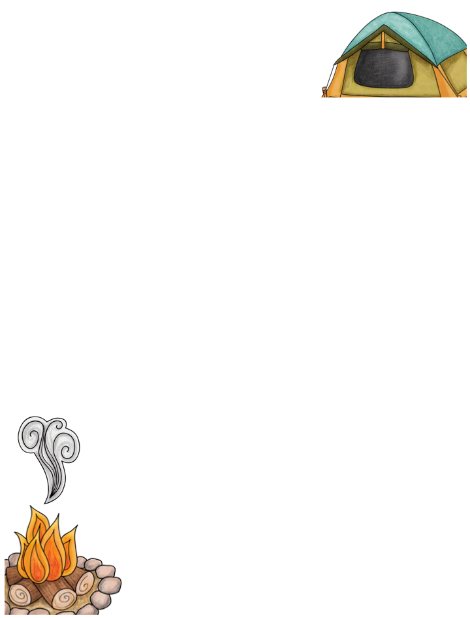
Our __ Grade
Classroom News
The Week of xxxxxxxxxxxxxx
Email: {teacher’s email address}
Twitter: @twitteraccount Website: classwebsite.com
Important Dates
Reminders
Text
Text
Supporting Your Student at Home
What We’re Learning This Week
Reading | Math | Science | Social Studies

Slide 45

Our __ Grade
Classroom News
The Week of xxxxxxxxxxxxxx
Email: {teacher’s email address}
Twitter: @twitteraccount Website: classwebsite.com
Reminders
Reminders
Text
Text
Supporting Your Student at Home
What We’re Learning This Week
Reading | Math | Science | Social Studies

