Slide 1
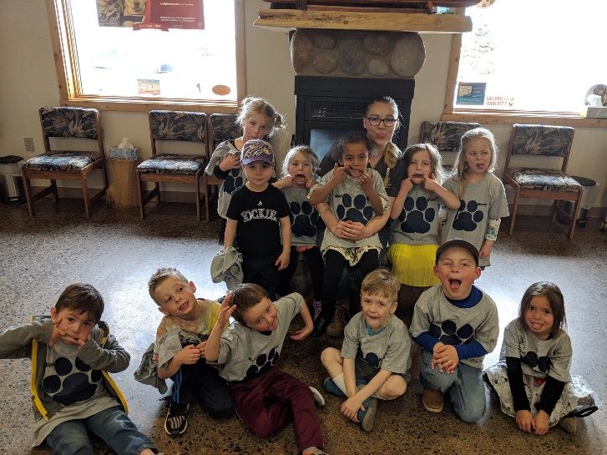
April
Week of the 1st
Theme – W weather
Reminders
April 2nd Board Meeting 5:30
April 4- Art Show, UW Art Museum 5:30-6:30
April 8-12th Week of the Young Child
April 9th Last Day of Swimming
April 15th & 17th Parent Teacher Conferences
Monday…….....Healthy Rx (pm)
Tuesday………..Swimming (pm)
Wednesday.….Spanish (am) Music/Cooking (pm)
Thursday……….Library (pm)
Friday……….…..Art (pm)
Peek at the Week
The kids enjoyed the field trip to the Alpine Animal Hospital. They saw many cool things. They all got on the big animal scale together and they weighed 542 pounds.
We said goodbye to Bree this week she is leaving to go to her mom’s in home day care. She will be missed.
Parent teacher conferences will be April 15th and April 17th times will be posted on my bulletin board this week.
Our spring raffle is starting April 15th – more information will be in cubbies.
Thank you to Wilson, Tristan, Ariana, Senna, Scarlett, and Bree
for bringing snack last week☺
Contact info….
Phone: 307-745-7256
prek2class@laramieopenschool.org

