Slide 1
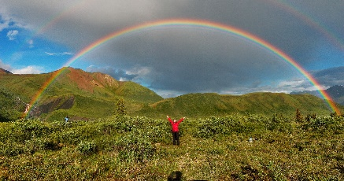
March
Week of the 19th
Letter Uu Umbrella/Rainbows
Reminders
March 26th Open School Art Show
5:30-6:30 @ UW Art Museum
April 2nd & 3rd No School
April 3rd Parent Teacher Conferences
April 24-26th Spring Photo Days (graduation and individual photos)
May 16th Year End Celebration 6:00pm
Our last Ranger of the Week was Tristan Georgi. The kids loved seeing Tristan with “really long hair” and the picture with him and the “million candies.”
Monday…….....Science (pm)
Tuesday………..Swimming (pm)
Wednesday.….Music (pm)
Thursday……….Library (pm) & Cooking (pm)
Friday……….…..Art (pm)
Peek at the Week
I hope everyone had a wonderful spring break. I am sure the kids are ready to come back to school and see their buddies. I know I have missed seeing the kids.
This upcoming week we are going to learn about rainbows and do activities that rainbow related. We also won’t be having movement on Monday – CrossFit 7220 had other obligations that day.
Also, parent teacher conferences are coming up. Please see my bulletin board for times to sign up. If you can’t do any of the times posted let me know and we can make other arrangements.
Thank you to everyone who has given me words for the rainbow clouds. If you haven’t its ok, still bring them in. For the Acrostic poem all you need to do is
r bring me words that describe your child. All you need to do is use an adjective that best describes them for each letter of their name. For example: Carrie (Caring, Adventurous, Reliable, Responsible, Independent, Easygoing). Thanks ☺
Thank you to Owen, Ava, Cael, Camden, and Hayden for bringing snacks last week.
Contact info….
Phone: 307-745-7256
prek2class@laramieopenschool.org

