Slide 1
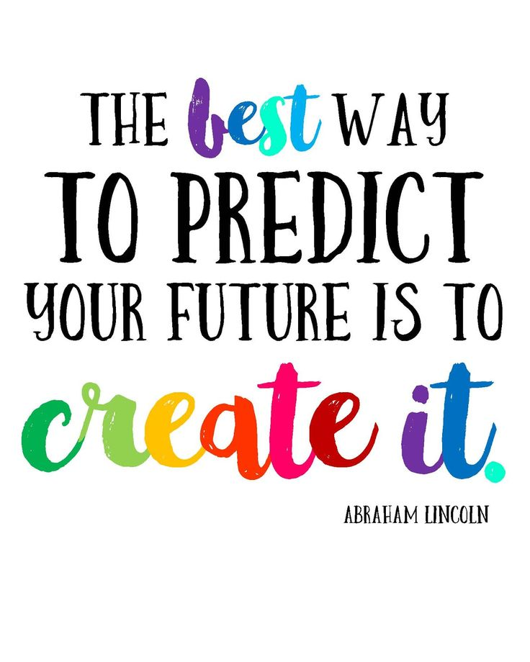
January
Week of the 7th
Letter N
Enrichments
Monday……....
Tuesday………..Science (pm)
Wednesday.….Cooking (pm)
Thursday………
Friday……….…..Art (pm)
Reminders
January 21st – Closed
Peek at the Week
I hope everyone had a wonderful break and enjoyed some family time. I sure did. I am ready to get back into the swing of things and be with your kids. I sure did miss my class.
This week we are going to talk about kindness, friendship, and do some activities centered around the book, The Mitten.
We have a new girl joining us this week, her name is Senna. We are excited to have her join us☺.
Cubbies have been cleaned and swapped around. Please bring back a fresh change of clothes, slippers, and water bottle.
Kids are welcome to bring in something to share this week. They will be able to bring it all week and play with during centers. They will only get to share one time. We will share all week, so everyone will get a chance to share.
Happy New Year
Contact info….
Phone: 307-745-7256
prek2class@laramieopenschool.org

