Slide 1
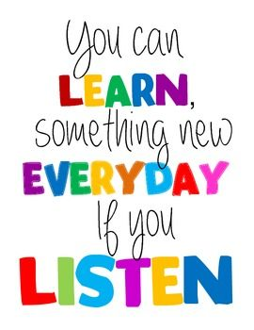
January
Week of the 16th
Letter Mm – The Mitten
Reminders
January 15th – No School MLK Day
Januuary 16th Dominos Pizza Night
January 22nd Movement at 7220
January 23rd – Swim Lessons Begin
Monday…….....
Tuesday………..Science (pm)
Wednesday.….Cooking and Music (pm)
Thursday……….Library (pm)
Friday……….…..Art (pm)
Arlo was the ranger of the week.
We loved seeing all of Arlo’s
Adventures. We especially liked the
Photo of Arlo in being a ninja in
his dads underwear.
Peek at the Week
We have a new student in our class that everyone is excited about. Her name is Gracyn. All of the kids welcomed her with open arms to our classroom.
The class has loved doing Lego activities – who doesn’t. I think the classes favorite was playing Roll a mini figure and Lego bingo. We did lots of math with the Legos too. Everything from patterning to engineering a bridge.
Swimming and CrossFit will begin the week of January 22nd. I am very excited to work with 7220 – they have an awesome team of people what work well with kids. If your child attends on Monday they will need to fill our a release form before they attend. Forms will be your cubbies next week.
The next week we will doing activities focused on “The Mitten” by Jan Brett . We will read other stories by Jan Brett and do some comparing and contrasting.
Please remember to bring in cubby items – several kids are still missing a change of clothes, water bottles, and slippers.
Thank you to Axel, Elsie, Bodhi, Sophia F, and Grace for bringing snacks last week.
Contact info….
Phone: 307-745-7256
prek2class@laramieopenschool.org

